Slide 1
546 HW6 report
Zhenyan Liu

Slide 2
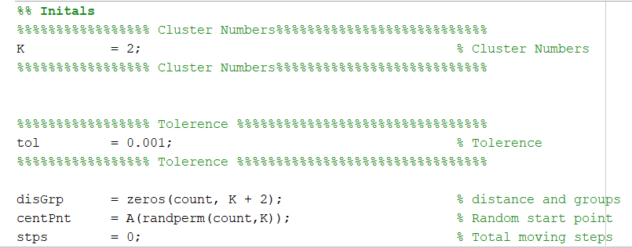
Variables:
1. Change the “K” to run the code in different clusters.
2. Change the “tol” to run the code in different tolerance.
Tolerance = max(current_step(movement)-previous_step(movement))

Slide 3
Files and outputs:
1. Code will generate the 1D.ps or 2D.ps in the working directory.
Those files can be convert to pdf with online resources.
2. Files submitted:
a. hw6CSC546_1D.m 1D code
b. hw6CSC546_2D.m 2D code
c. 1DK2.pdf 1D 2clusters test output file
d. 1DK3.pdf 1D 3clusters test output file
e. 2DK2.pdf 2D 2clusters test output file
f. 2DK3.pdf 2D 3clusters test output file

